Slide 1
Launching and Marketing
SE495: Software Entrepreneurship

Slide 2
Outline
Launching your software product
Growing your first customer base
Onboarding and retaining customers
Scaling your business
Common challenges and lessons learned

Slide 3
Launching your software product

Slide 4

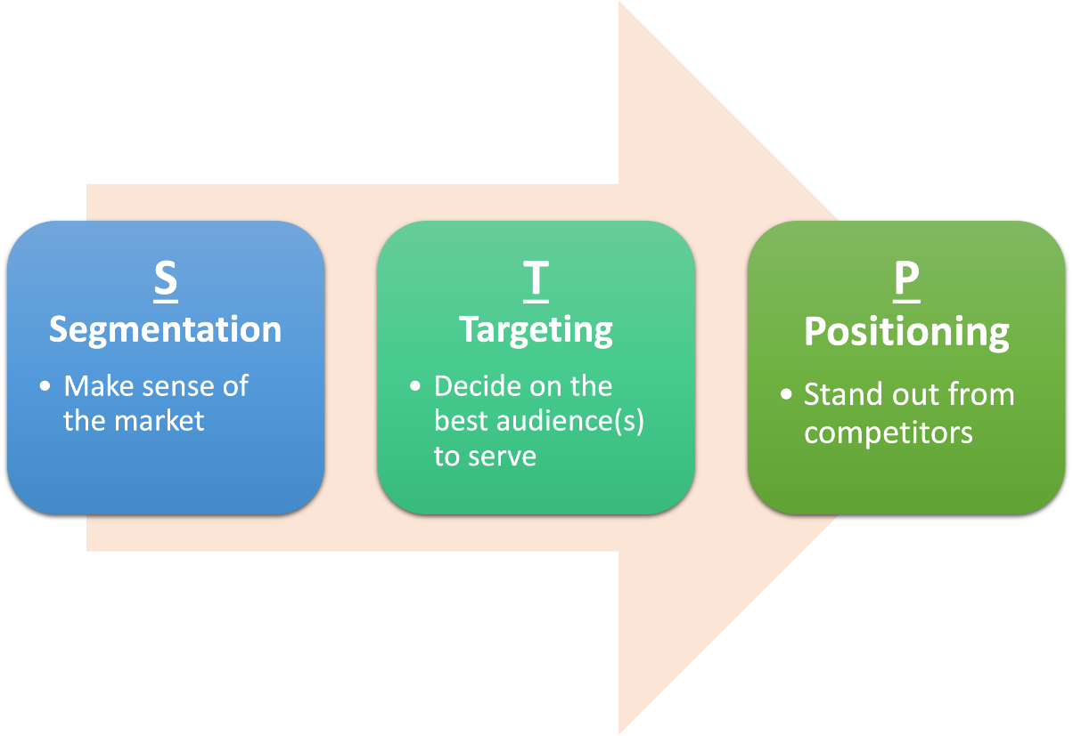
Understanding Your Target Market
Identifying your ideal customer
Understanding their needs, pain points, and motivations
Validating your product-market fit

Slide 5
Defining Your Launch Strategy
Different launch strategies
Soft launch
Launching a product or service to a limited audience in order to get feedback and make improvements before launching to the general public.
Hard launch
Launching a product or service to the general public all at once.
Phased launch
Launching a product or service to different market segments or geographic regions over time.

Slide 6

Defining Your Launch Strategy
Factors to consider when choosing a launch strategy
Market conditions
Product complexity and maturity
Competition
Budget and risk
Aligning your launch strategy with your business goals

Slide 7
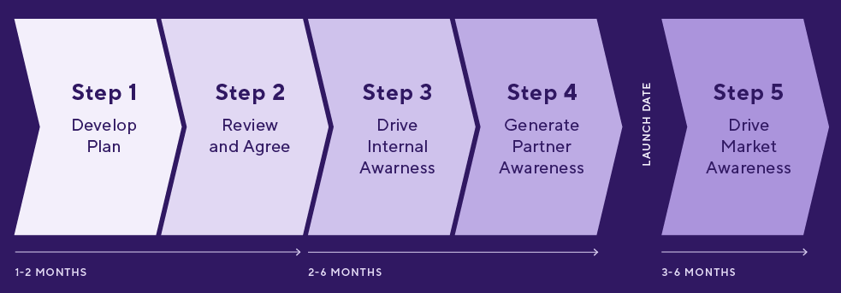
Planning Your Launch Timeline
Creating a timeline for your launch plan
Milestones to include in your timeline (e.g. product development, marketing campaigns, launch date)
Allocating resources and assigning responsibilities

Slide 8
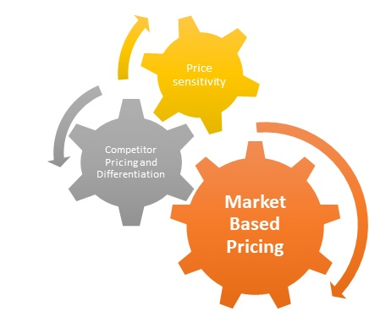
Pricing Your Product/Service
Understanding your pricing options (e.g. freemium, subscription, perpetual license)
Factors to consider when setting your price (e.g. costs, competition, customer perceived value)
Strategies for optimizing your pricing
Price anchoring
Tiered pricing

Slide 9
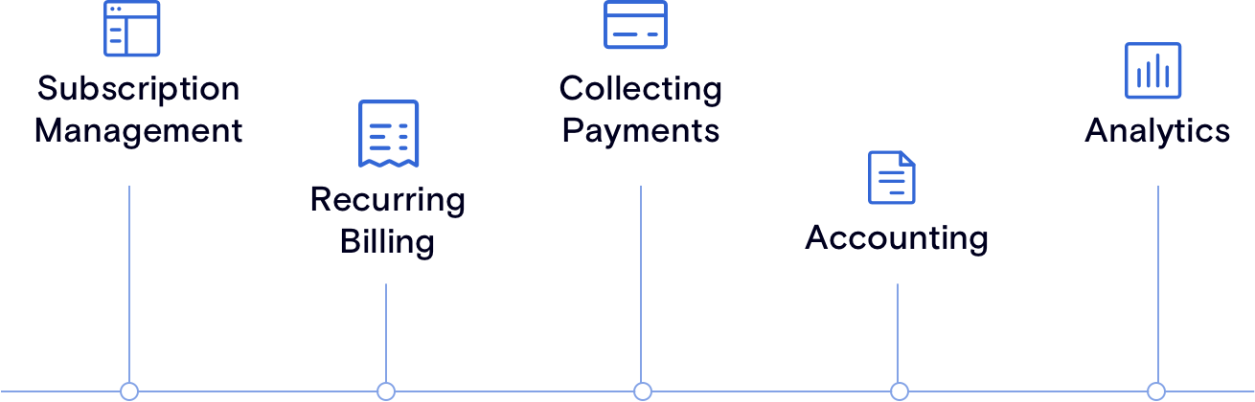
Setting Up Billing/Payment Systems
Different billing and payment systems (e.g. Stripe, PayPal, invoicing)
Factors to consider when choosing a billing/payment system (e.g. security, ease of use, integrations)
Setting up and testing your billing/payment system

Slide 10

Producing Promotional Materials
Different promotional materials (e.g. videos, demos, tutorials)
Factors to consider when creating promotional materials (e.g. target audience, message, production quality)
Best practices for creating effective promotional materials

Slide 11
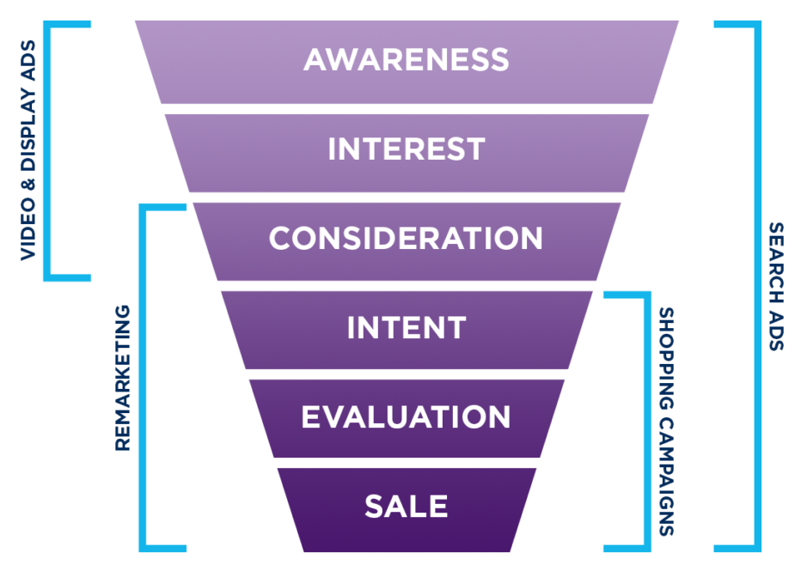
Measuring Launch Success
Defining success metrics for your launch
revenue, user acquisition, customer satisfaction
Analytics and tracking systems to measure success
Strategies for iterating and improving

Slide 12
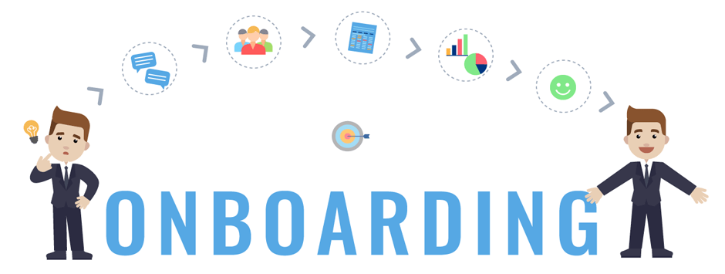
Post-Launch Activities
Customer onboarding
Feedback collection
Upselling/cross-selling
Strategies for maximizing customer lifetime value
Planning for future product development and enhancements

Slide 13
Growing your first customer base

Slide 14
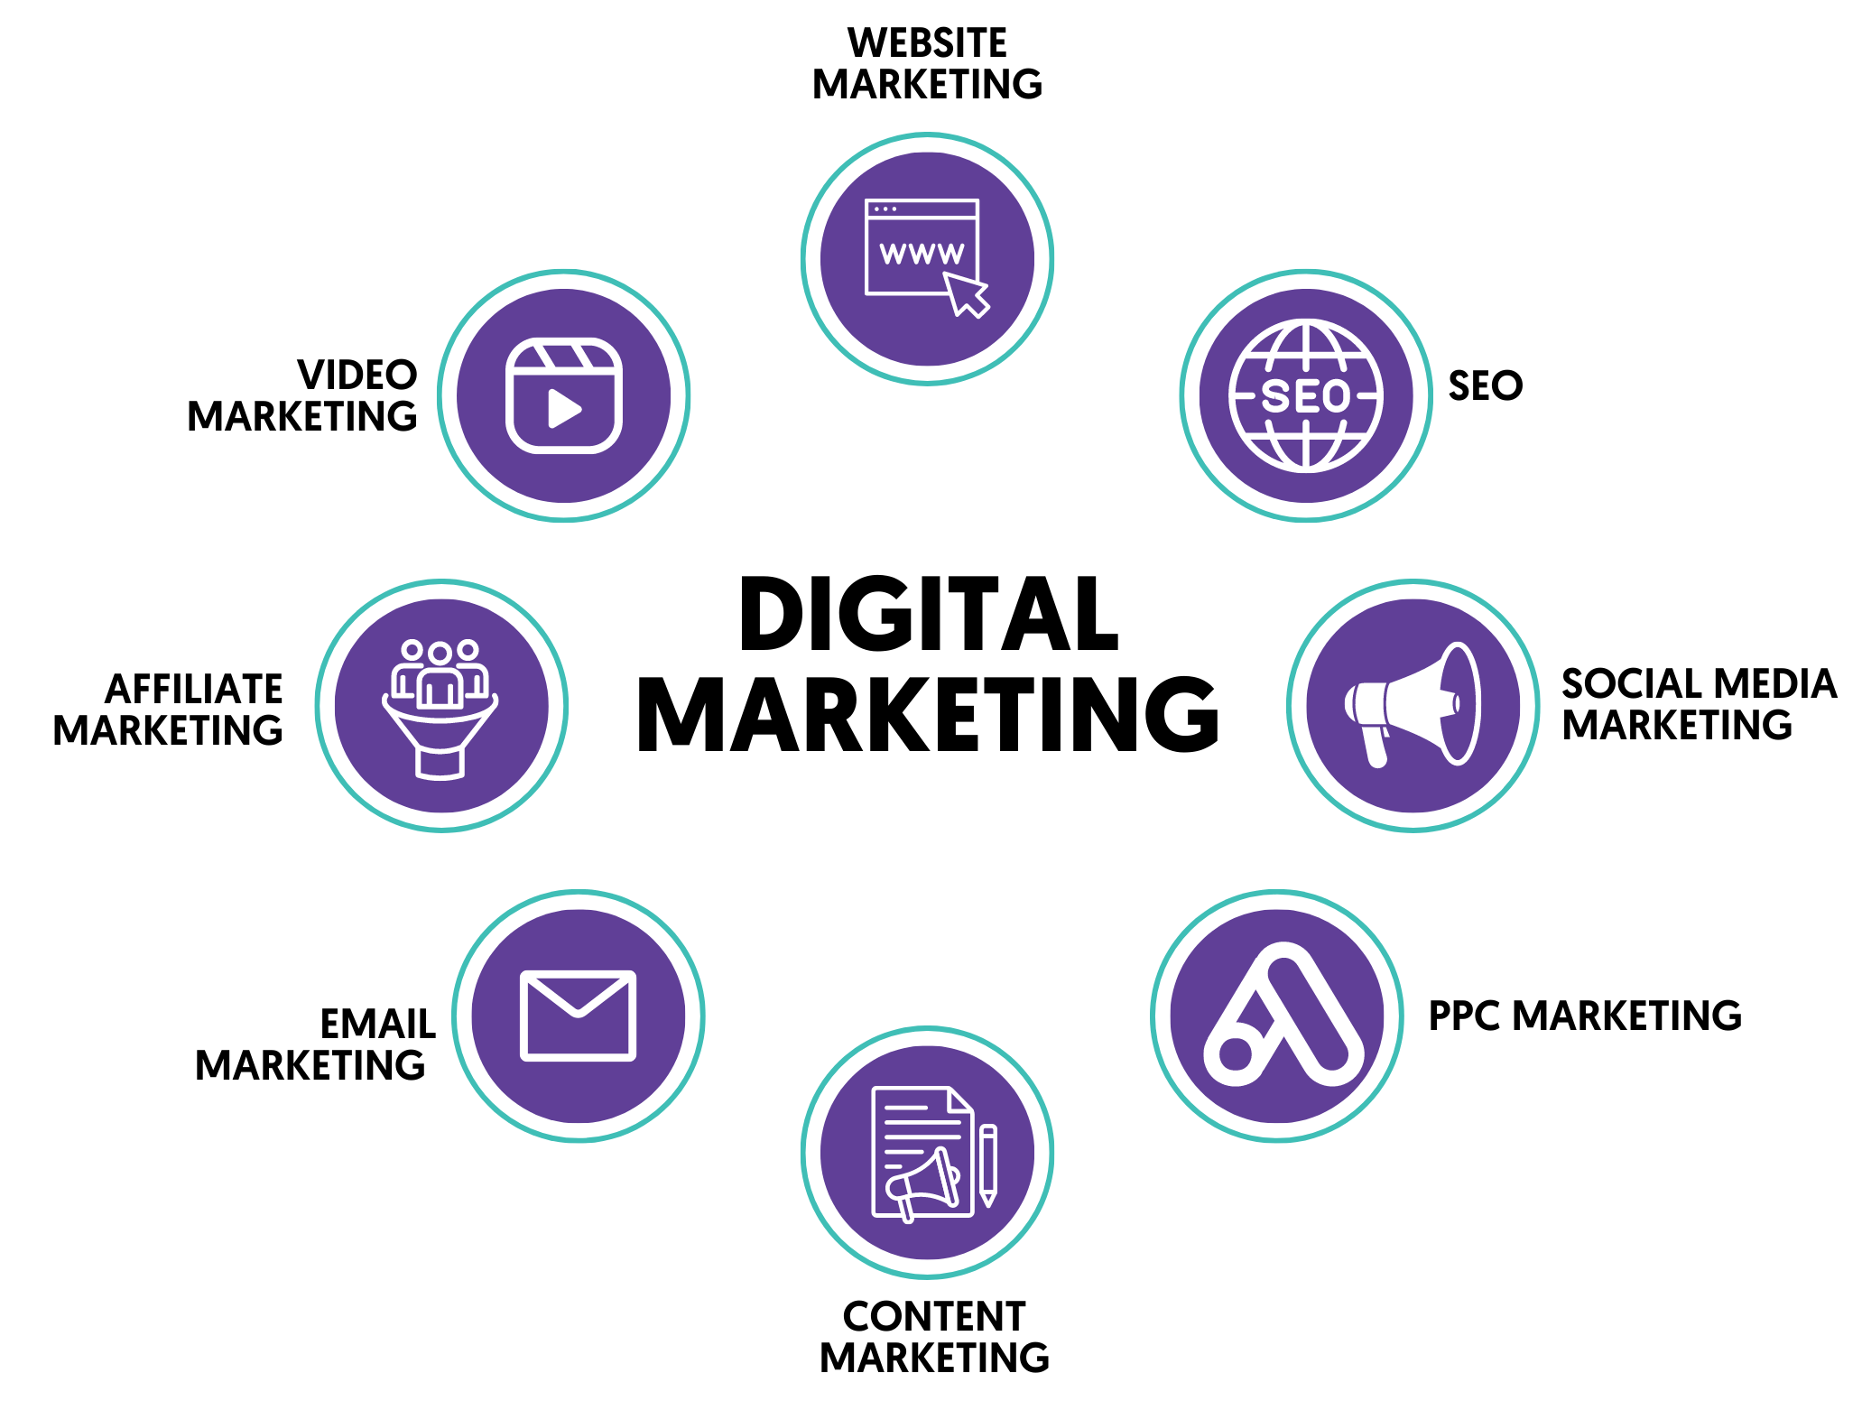
Digital Marketing Tactics

Slide 15
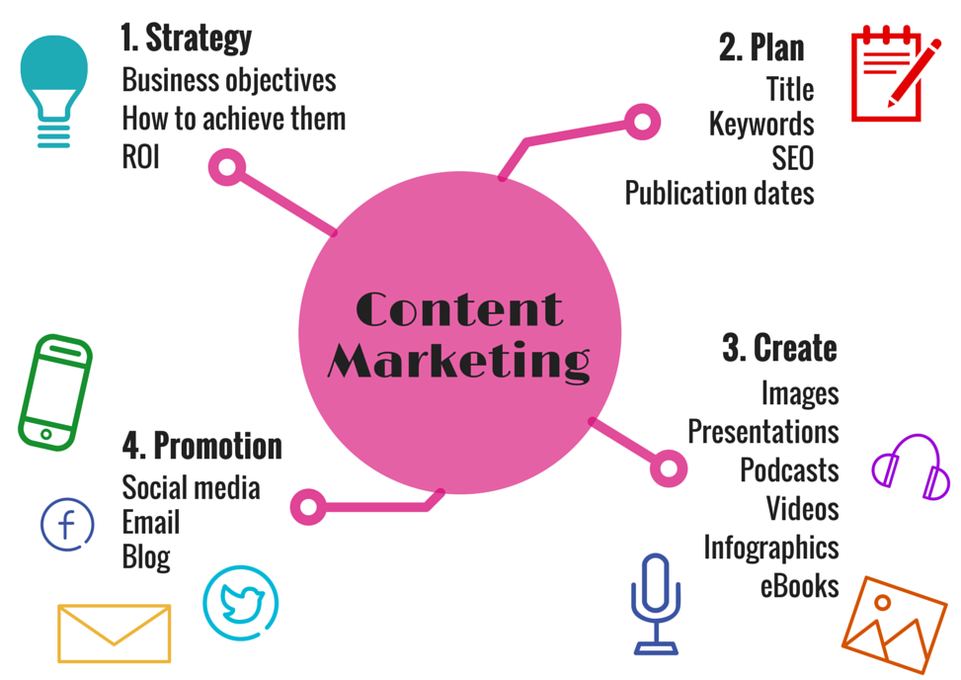
Content Marketing and Blogging
Attracting and engaging potential customers
Create a content marketing strategy that aligns with your business goals
Tips for creating high-quality, engaging blog posts that resonate with your target audience

Slide 16

Email Marketing Campaigns
Building an email list and how to do it effectively
Strategies for creating successful email marketing campaigns that drive conversions
Tips for personalizing and segmenting your email campaigns to improve engagement

Slide 17

PR and Influencer Outreach
Public relations (PR) and its role in growing your customer base
Strategies for identifying and leveraging influencers in your industry to reach new audiences
Tips for crafting effective press releases and pitches that get noticed by media outlets

Slide 18
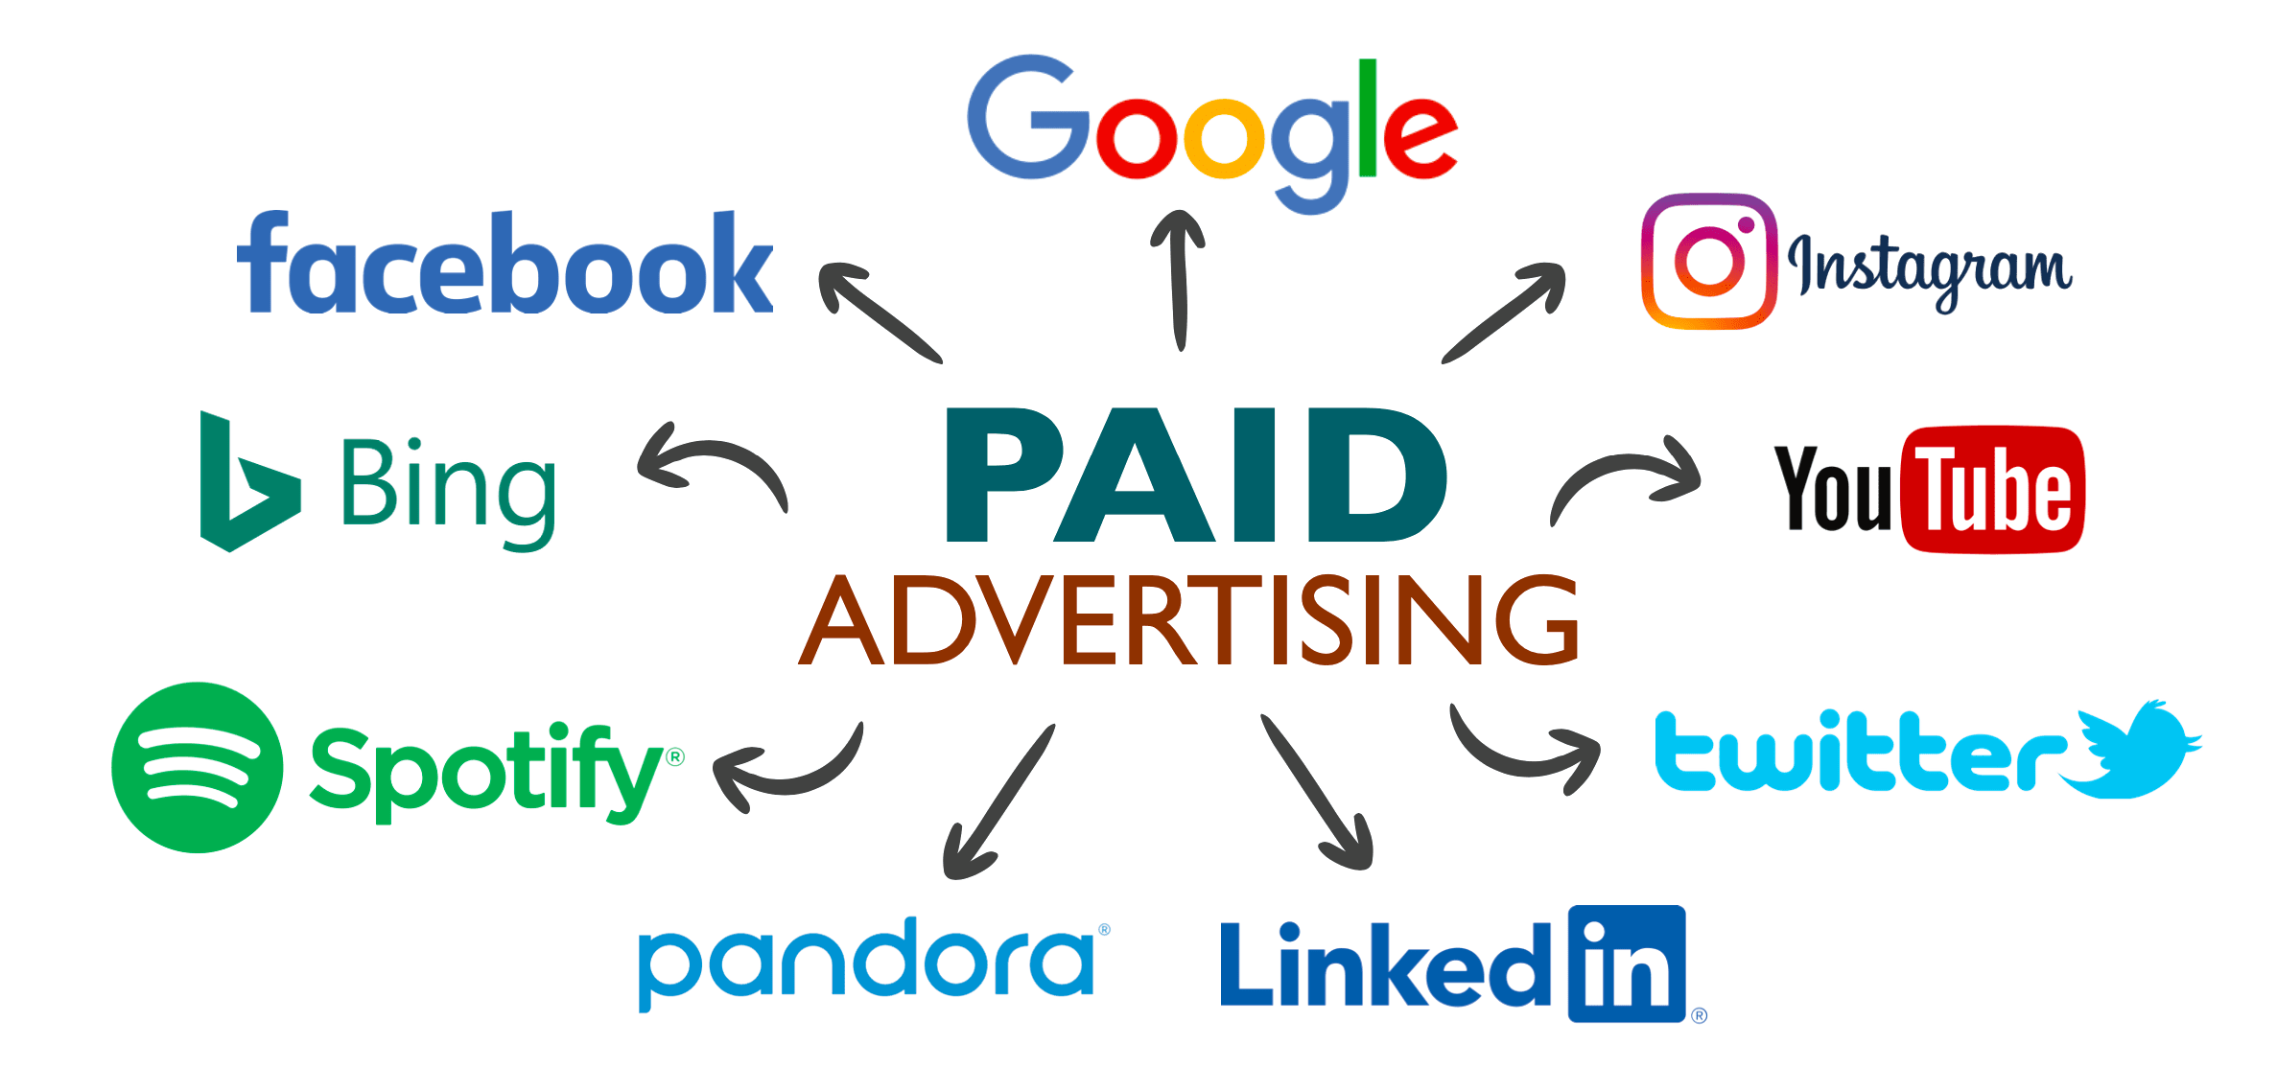
Paid Advertising

Slide 19
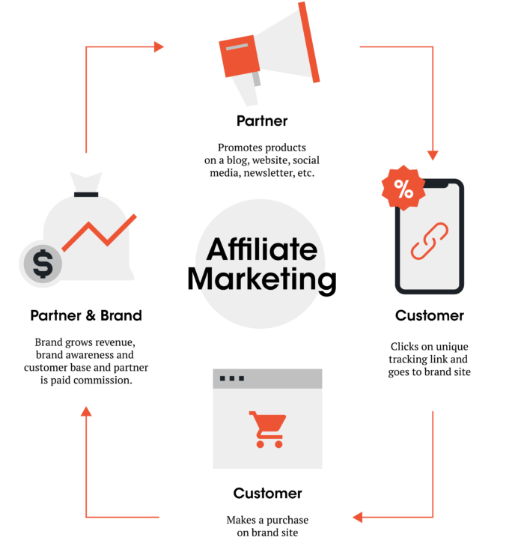
Partnerships and Affiliate Programs
Partnerships and affiliate programs as a means of expanding your customer base
Strategies for identifying and leveraging potential partnerships and affiliate opportunities

Slide 20
Onboarding and retaining customers

Slide 21

Customer Support Strategies
Customer support is crucial for retaining customers as it directly impacts their satisfaction and loyalty towards a company.
Email Support
Phone Support
Chat Support
FAQs and Knowledge Base

Slide 22
Customer Support Strategies
Strategies for providing effective customer support:
Prompt Response Times
Personalized Support
Empowering Customers with Self-Service Tools
Continuous Training for Support Agents
Gathering and Utilizing Customer Feedback

Slide 23
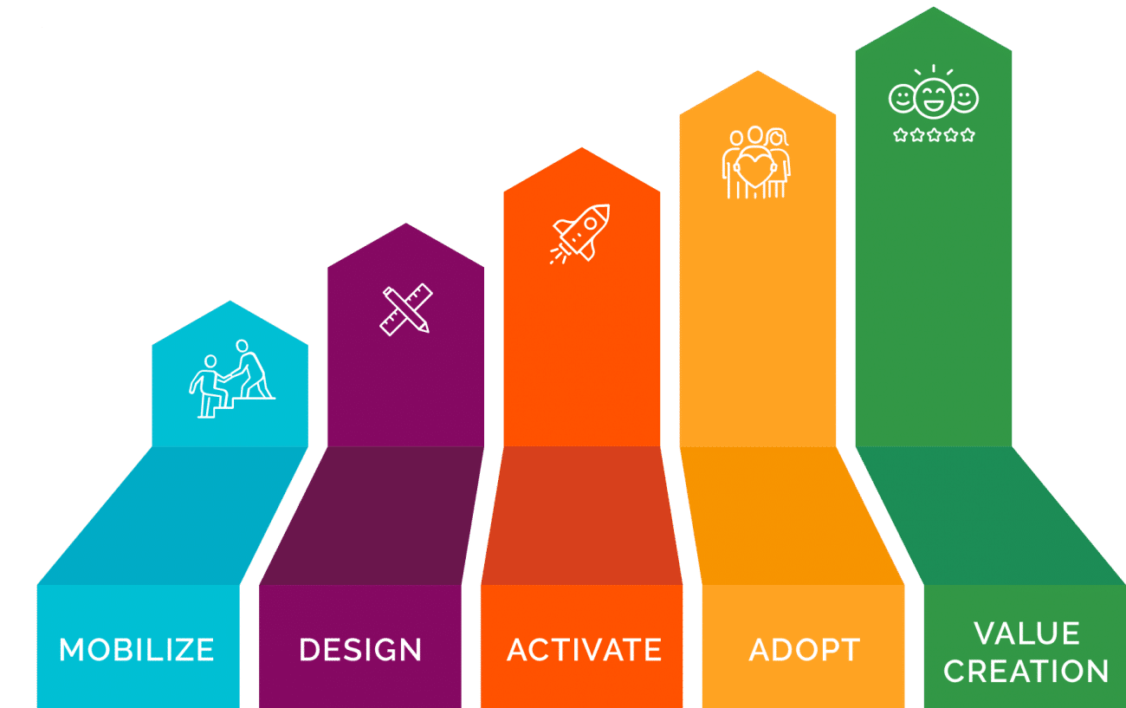
Post-Sales Onboarding Flow
Importance of onboarding customers after purchase:
Maximizing Product/Service Value
Minimizing Churn
Building Customer Loyalty

Slide 24
Post-Sales Onboarding Flow
Tips for ensuring customers are successfully onboarded:
Clear Communication
Timely Follow-ups
Personalized Assistance
Continuous Education
Monitor Customer Progress and Satisfaction

Slide 25
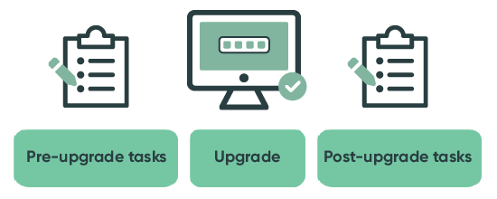
Implementing Upgrades/Updates
Importance of keeping your product up-to-date and relevant:
Competitive Advantage
Customer Satisfaction
Security and Stability

Slide 26
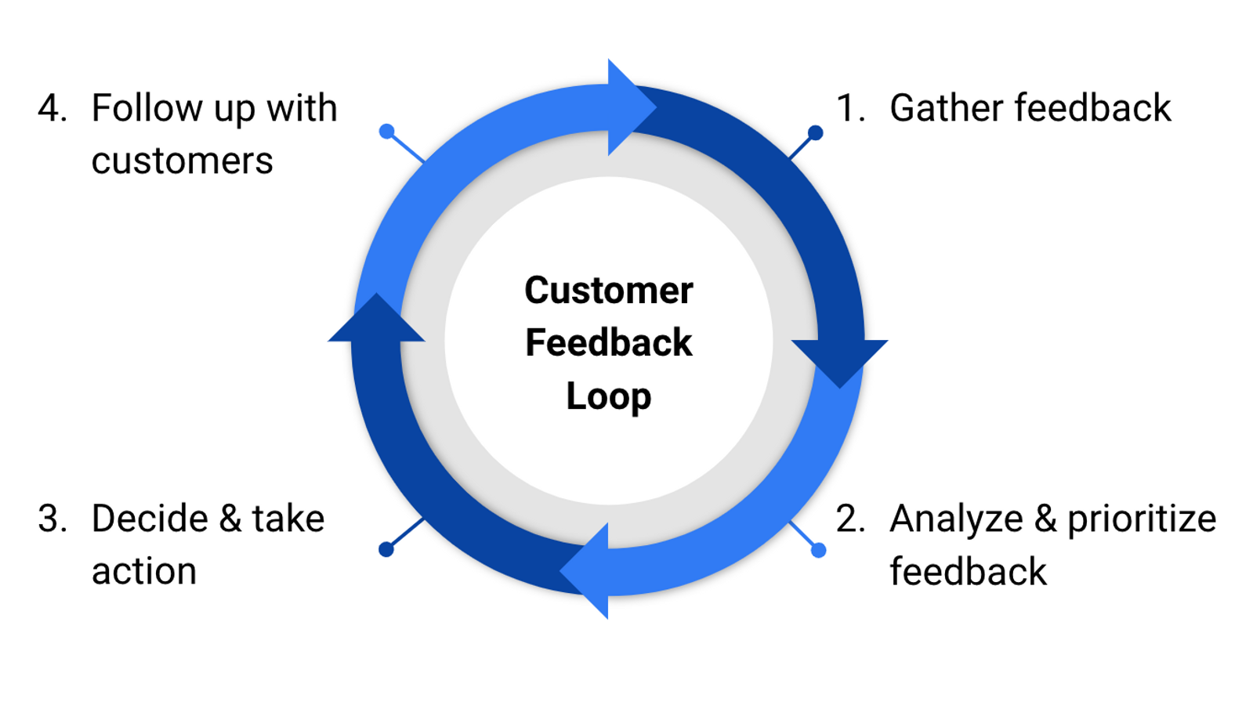
Implementing Upgrades/Updates
Tips for communicating upgrades and updates to customers:
Clear Messaging
Advance Notice
Training Resources
Release Notes
Two-Way Communication

Slide 27
Building Loyalty Programs
Importance of building customer loyalty
Strategies for creating effective loyalty programs (e.g. rewards, discounts, exclusive access)
Tips for making loyalty programs work for your business (e.g. personalized offers, tiered rewards, recognition of customer milestones)

Slide 28
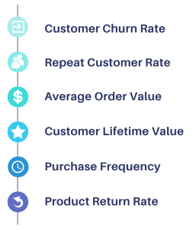
Customer Retention Metrics
Importance of tracking customer retention metrics
Business Sustainability
Customer Satisfaction and Loyalty
Revenue Growth

Slide 29
Scaling your business

Slide 30
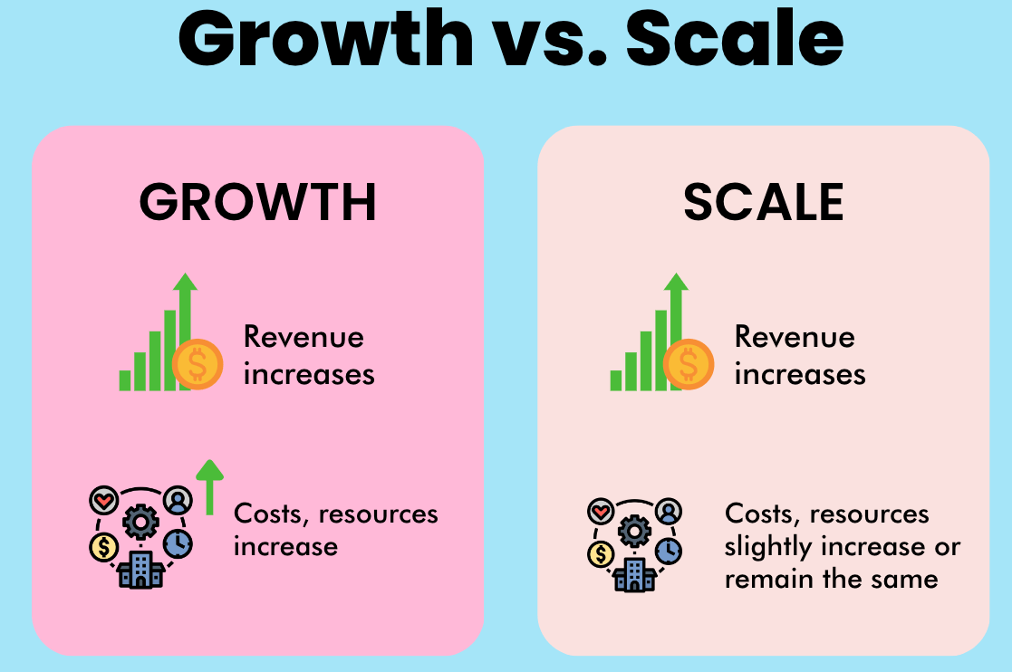
Growth and Scaling
Growth refers to the increase in size, revenue, or market presence of a company over time.
Scaling refers to the ability of a company to handle increased workload, expand its operations, and maintain efficiency as it grows.

Slide 31
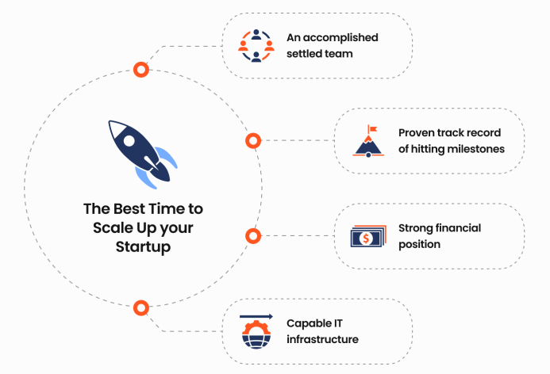
Importance of Scaling for Software Startups
Meeting customer demand
Improving profitability
Competitive advantage

Slide 32
Scaling
Horizontal
Vertical
Hybrid

Slide 33
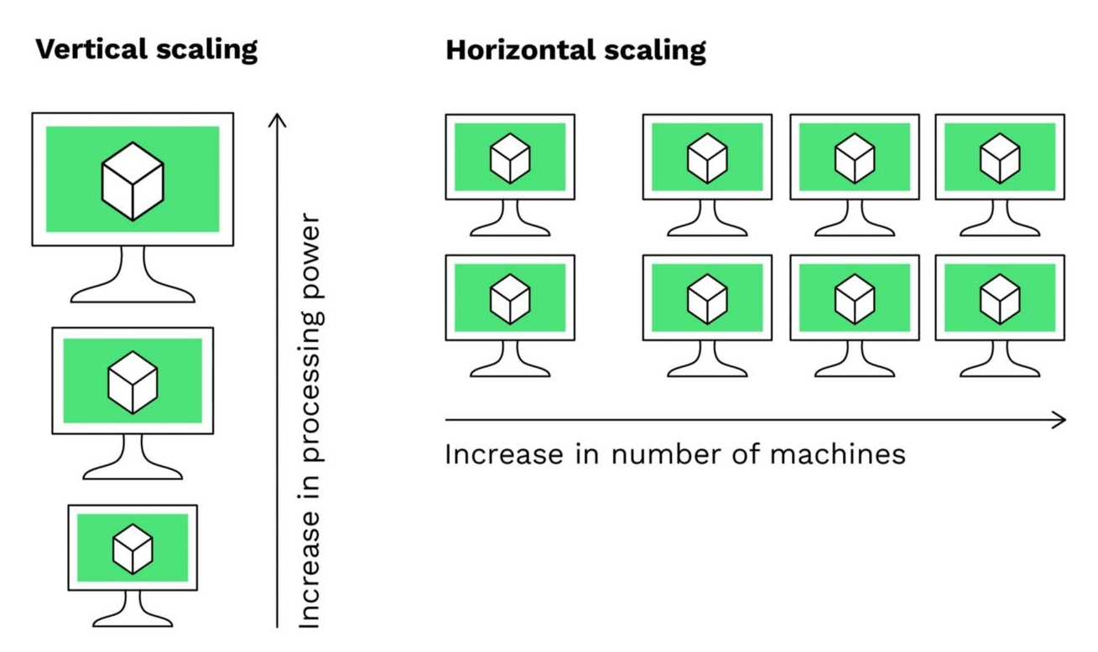
Horizontal Scaling
Horizontal scaling, also known as scaling out
refers to the process of adding more resources (servers, machines, etc.) to a system in order to handle increased workload or traffic.
It involves distributing the workload across multiple machines, allowing for improved performance, increased capacity, and better fault tolerance.

Slide 34
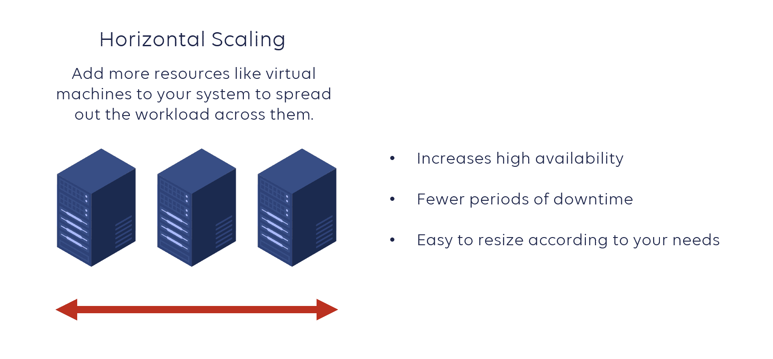
Examples of Horizontal Scaling
Adding more servers
Increasing bandwidth
Load balancing

Slide 35
Pros and Cons of Horizontal Scaling
Pros of Horizontal Scaling:
Improved performance and scalability
High availability and fault tolerance
Cons of Horizontal Scaling:
Increased complexity:
Cost implications:

Slide 36
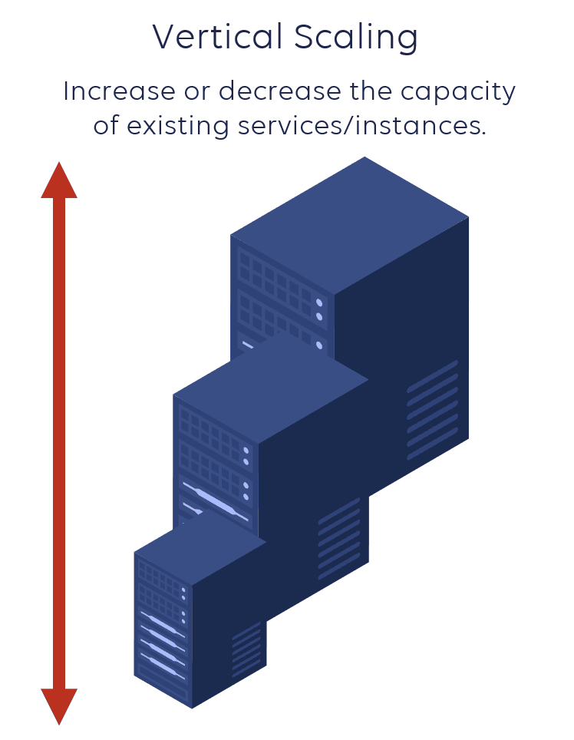
Vertical Scaling
Vertical scaling, also known as scaling up
refers to the process of increasing the capacity or power of individual servers or machines in a system.
It involves upgrading the hardware components, such as CPU, RAM, or storage, to handle increased workload or resource requirements.

Slide 37
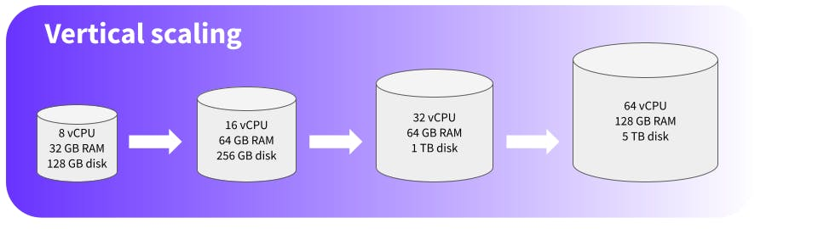
Examples of Vertical Scaling
Increasing server resources
Upgrading hardware
Optimizing software configuration

Slide 38
Pros and Cons of Vertical Scaling
Pros of Vertical Scaling
Simplicity and ease of implementation
Cost-effective for specific workloads
Cons of Vertical Scaling
Limited scalability
Single point of failure

Slide 39
Hybrid Scaling
Hybrid scaling refers to a combination of horizontal scaling and vertical scaling techniques to achieve optimal performance and scalability in a system.
It leverages the benefits of both approaches to address specific workload requirements and optimize resource utilization.

Slide 40
Examples of Hybrid Scaling
Horizontal scaling with vertical upgrades
Vertical scaling with horizontal redundancy
Dynamic scaling based on workload

Slide 41
Pros and Cons of Hybrid Scaling
Pros of Hybrid Scaling
Optimal performance and scalability
Flexibility and cost-effectiveness
Cons of Hybrid Scaling
Increased complexity
Potential for misconfiguration

Slide 42
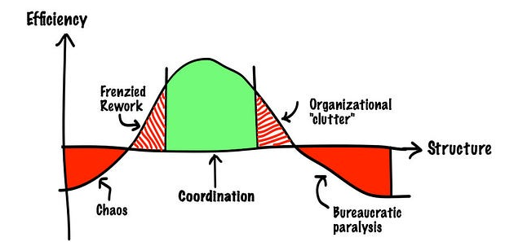
Managing Rapid Growth
The process of effectively scaling a company's operations, resources, and infrastructure to accommodate rapid increases in user adoption, customer demand, and revenue growth.
This involves a range of strategies, tactics, and best practices that help startup leaders navigate the challenges and opportunities associated with rapid growth, while ensuring the company's long-term success and sustainability.

Slide 43
Managing Rapid Growth
Scaling Operations
Managing Finances
Maintaining Culture
Balancing Short-term and Long-term Goals
Managing Talent
Optimizing Product Development
Ensuring Customer Satisfaction
Managing Risk
Building Strategic Partnerships
Staying Agile and Adaptable

Slide 44
Strategies for Managing Rapid Growth
Hiring and Onboarding
Training and Mentoring:
Improving Processes and Systems

Slide 45
Importance of Adapting to Change
Embracing Agility
Flexibility and Innovation
Scalability and Sustainability

Slide 46
Importance of Maintaining Quality and Consistency
Customer Satisfaction
Reputation and Brand Image
Long-Term Success

Slide 47
Strategies for Ensuring Quality and Consistency
Quality Assurance Processes
Performance Metrics and Monitoring
Standardization and Documentation

Slide 48
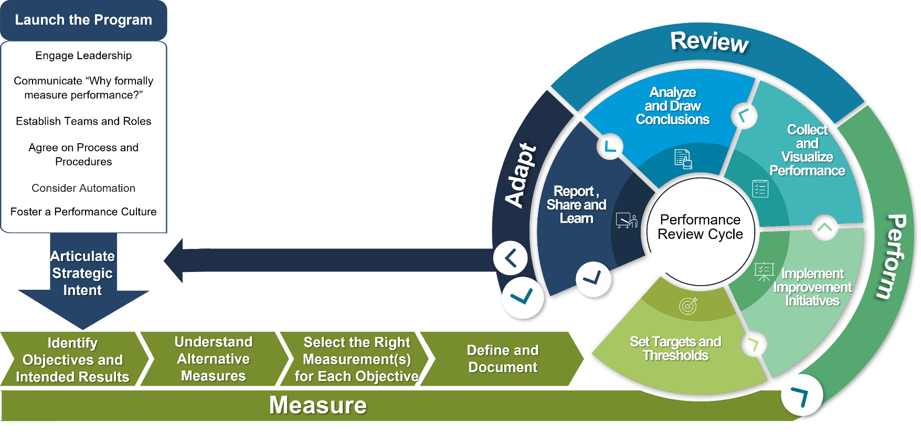
Analyzing Metrics and Key Performance Indicators
Importance of tracking and analyzing metrics for business growth:
Data-Driven Decision Making
Performance Evaluation
Optimization Opportunities

Slide 49
Developing Strategic Partnerships
Provides access to new markets, customers, and resources
Enhances credibility and reputation
Accelerates growth and scalability
Increases competitiveness and market share

Slide 50
Examples of Strategic Partnerships
Collaborations with complementary companies
Integrations with popular products or services
Joint marketing and sales initiatives
Co-creation of new products or features

Slide 51
Building and Nurturing Strategic Partnerships
Identify potential partners and evaluate their fit
Develop a clear partnership strategy and plan
Build relationships with key decision-makers
Communicate regularly and transparently
Foster a culture of collaboration and trust

Slide 52
Managing Finances for Software Startups
Budgeting and forecasting
Fundraising and investment
Cash flow management
Financial planning and analysis

Slide 53
Ensuring Financial Sustainability
Diversifying revenue streams
Building a strong financial foundation
Continuously monitoring and adjusting financial strategies
Seeking professional advice and guidance

Slide 54
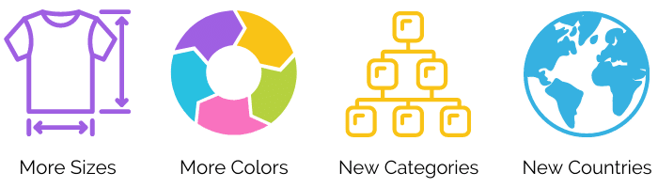
Expanding Product Offerings
Strategies for identifying new product opportunities:
Customer Feedback
Market Research
Industry Experts and Partnerships

Slide 55
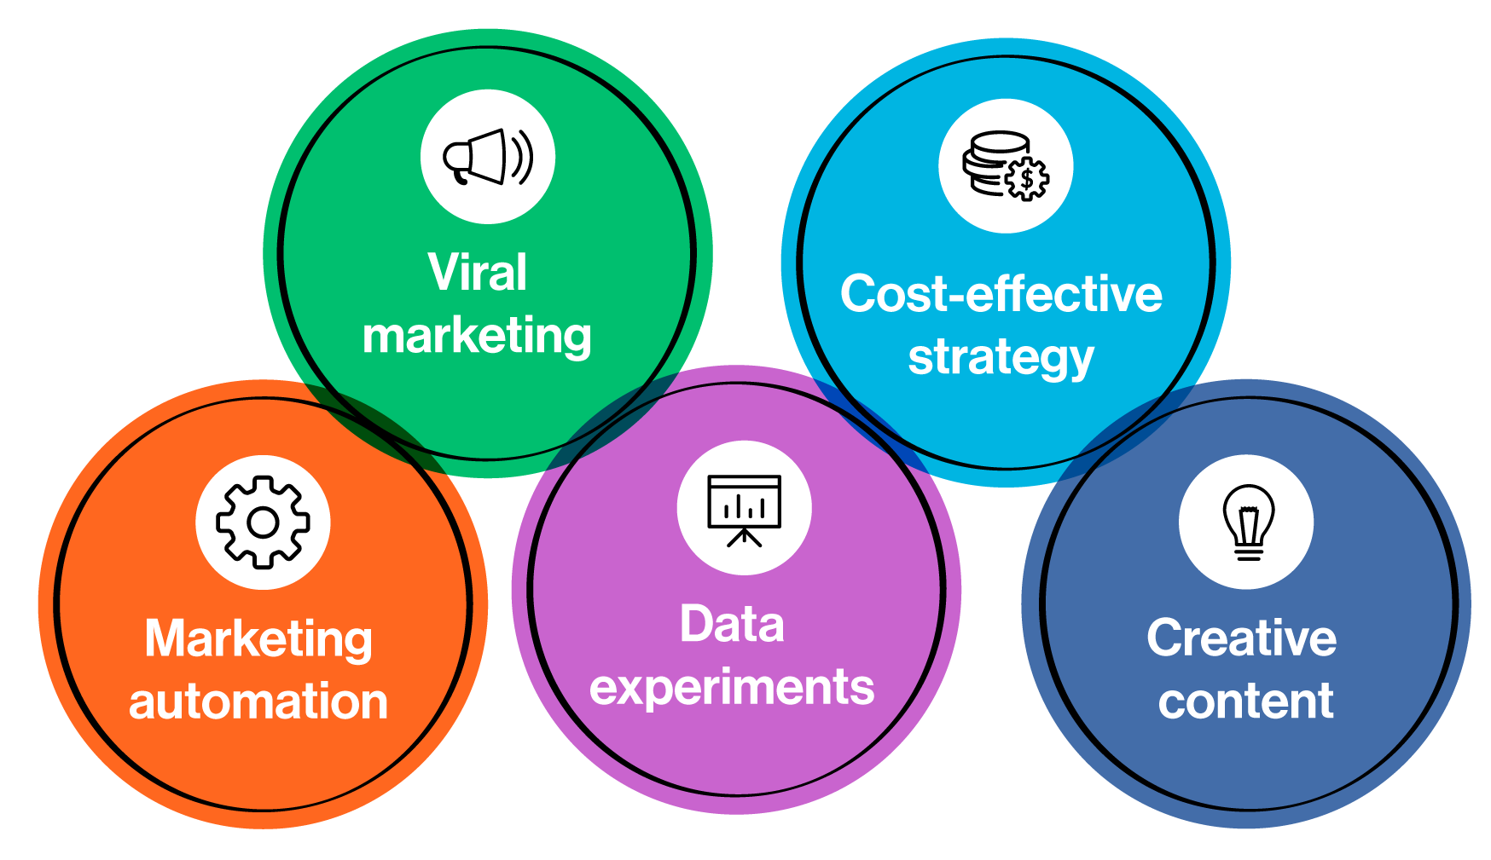
Growth Hacking Techniques
Growth hacking is particularly important in software entrepreneurship due to the digital nature of the business and the need for rapid user adoption.
Startups can leverage growth hacking techniques to gain initial traction, build a user base, and achieve exponential growth, even with limited resources.

Slide 56
Common challenges and lessons learned

Slide 57
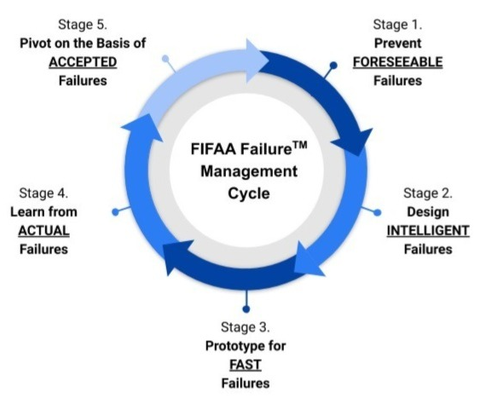
Handling Failures and Pivoting When Needed
Importance of embracing failure as a learning opportunity:
Growth and Innovation
Resilience and Adaptability
Continuous Improvement

Slide 58
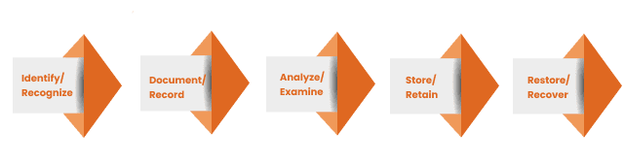
Handling Failures and Pivoting When Needed
Strategies for handling failures and learning from them:
Post-Mortem Analysis
Iterative Design
Feedback and Reflection
Growth Mindset

Slide 59
Successful pivots in software entrepreneurship
Twitter
Twitter initially started as a podcast platform called Odeo.
However, when Apple announced iTunes, which dominated the podcasting market, Odeo faced a significant challenge.
The team decided to pivot and focus on a new idea within the company, which eventually became Twitter.
This pivot led to tremendous success, transforming Twitter into one of the most popular social media platforms.

Slide 60
Successful pivots in software entrepreneurship
Instagram
Instagram began as a location-based social network called Burbn.
However, the founders noticed that the photo-sharing feature of Burbn was gaining more traction and engagement from users.
They decided to pivot and focus solely on photo-sharing, rebranding the platform as Instagram.
This pivot proved to be a game-changer, and Instagram became a leading photo and video-sharing app.

Slide 61
Successful pivots in software entrepreneurship
Slack
Slack initially started as a gaming company called Tiny Speck.
However, the company's game did not perform as expected.
The team shifted their focus and built a communication tool for internal use.
Recognizing its potential, they pivoted and rebranded as Slack, which eventually became a widely adopted team collaboration platform.

Slide 62
Legal and Compliance Considerations
Importance of understanding legal and compliance requirements for software startups
Common legal and compliance challenges faced by software entrepreneurs (e.g. intellectual property protection, data privacy)
Strategies for addressing these challenges (e.g. seeking legal advice, implementing compliance measures)

Slide 63
Competitive Analysis and Threats
Importance of conducting competitive analysis in software entrepreneurship
Strategies for identifying and analyzing competitors (e.g. market research, customer feedback)
How to respond to competitive threats (e.g. differentiating your product, improving customer service)

Slide 64
Potential Growth Barriers and Solutions
Common growth barriers faced by software startups (e.g. scalability, funding, talent acquisition)
Strategies for overcoming these barriers (e.g. leveraging cloud computing, seeking funding from venture capitalists, building a strong team culture)

